Slide 1

Jasmine & Augusto

Slide 2


Slide 3


Slide 4
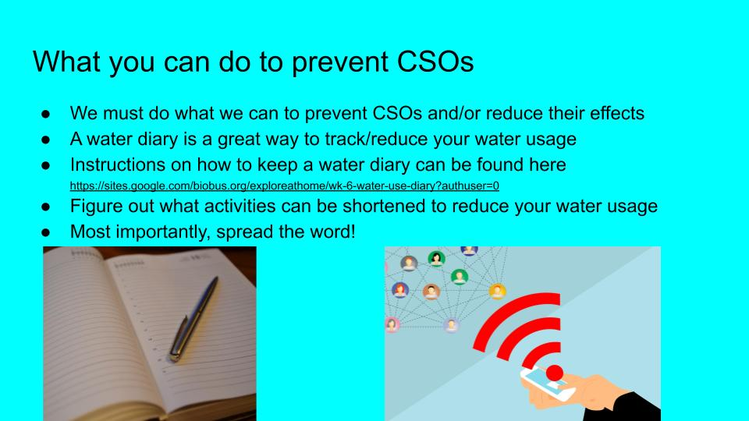

Slide 5
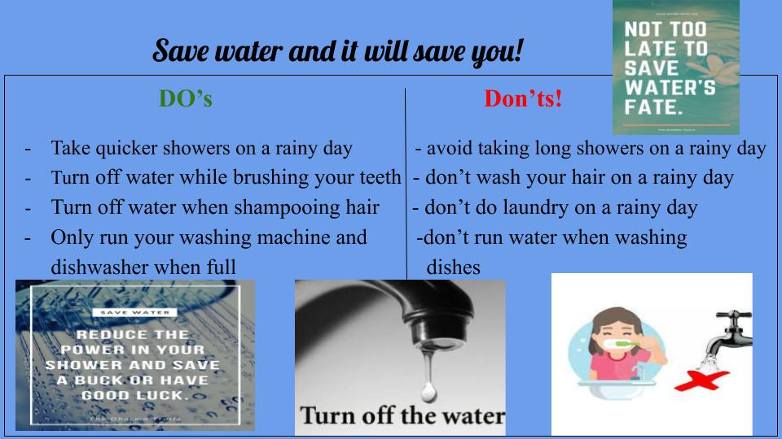

Slide 6


